Slide 1
Designing and Deploying
end-to-end
Production Grade ML Applications
Lecture 1: Intro
October 2025
Oliver Angélil; Cyrille Feudjio; Vincent Frimpong; Jan Ravnik

Slide 2
Contents of this lecture
Who are we?
Our career journeys
Ishango.ai
What is this AIMS course about?
Overarching goals
Skills prerequisites
Curriculum
Grading Breakdown
Slido Surveys
Get-to-know game
Deploying a basic end-to-end App on Google Cloud Platform (GCP)

Slide 3


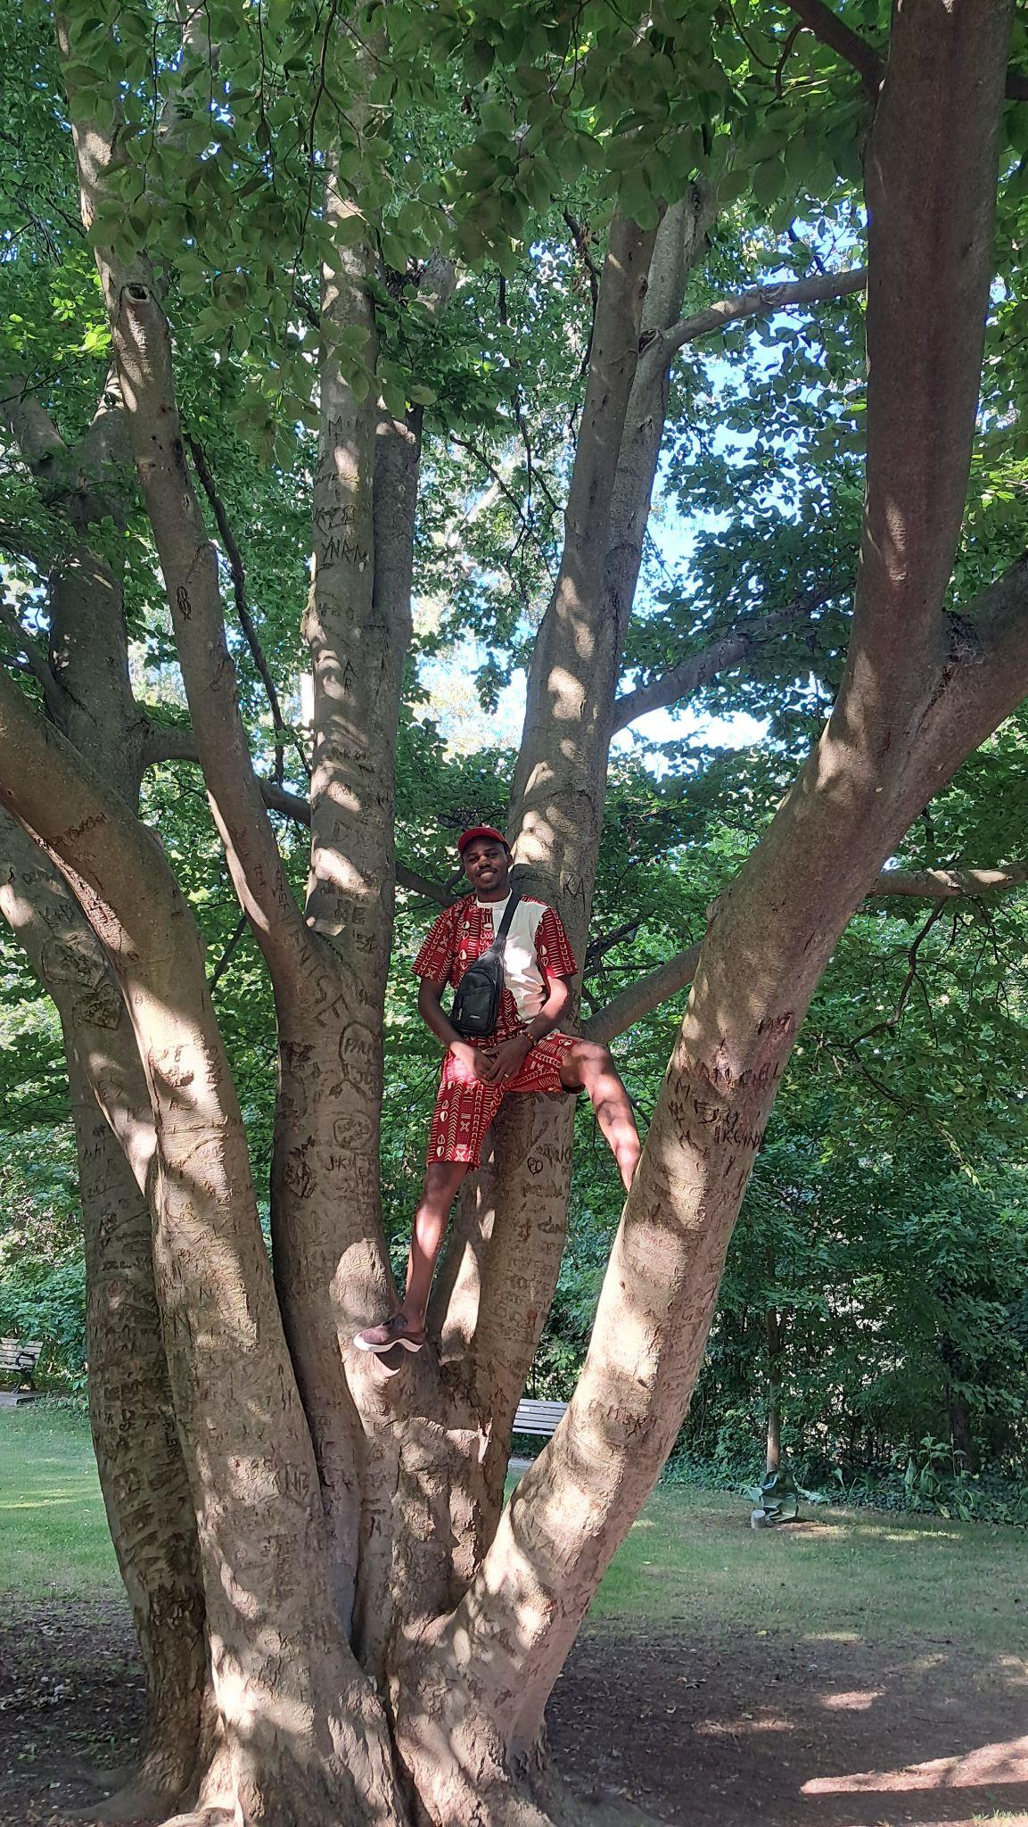



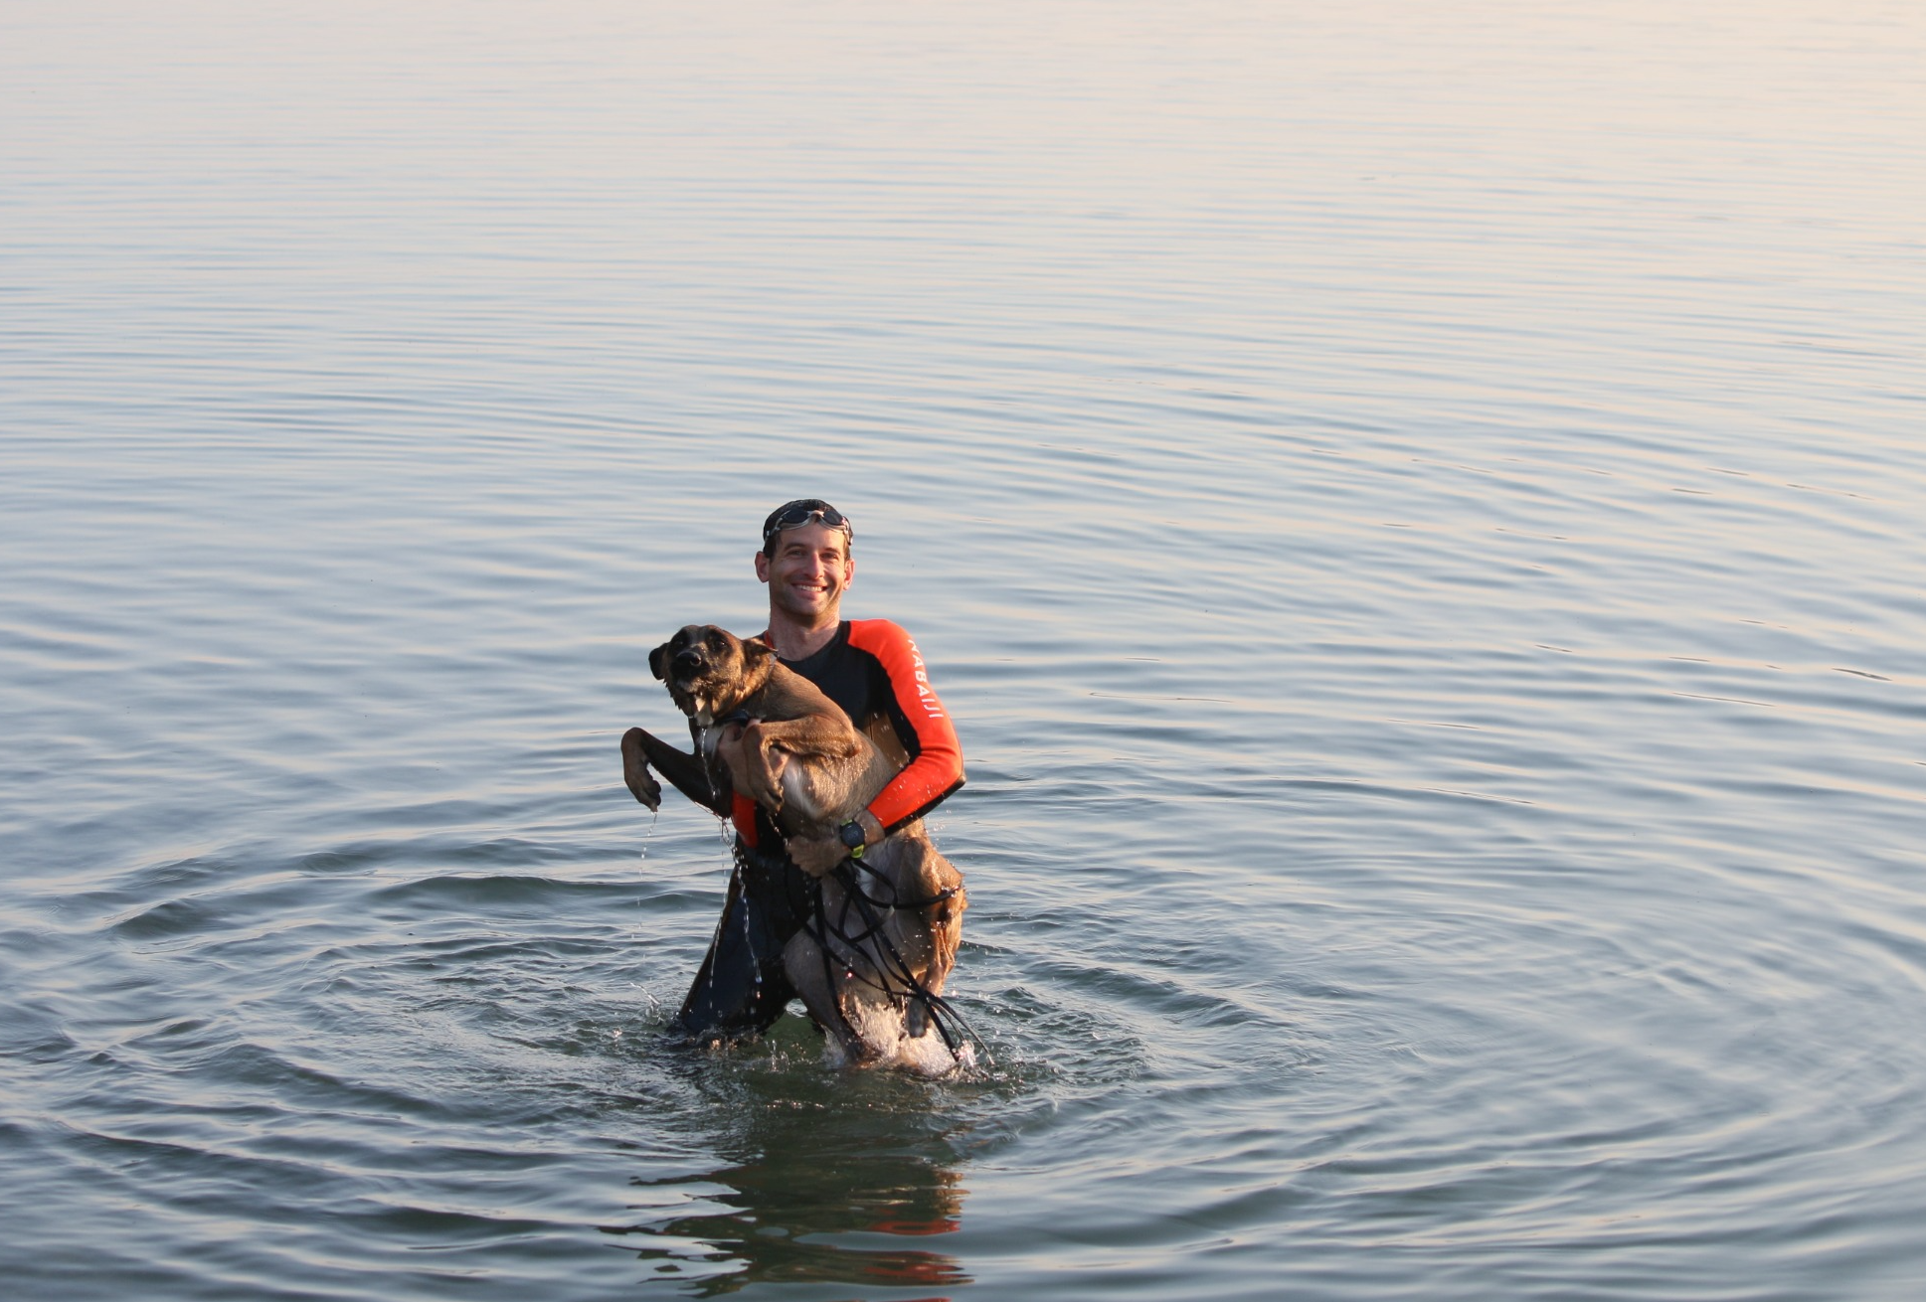

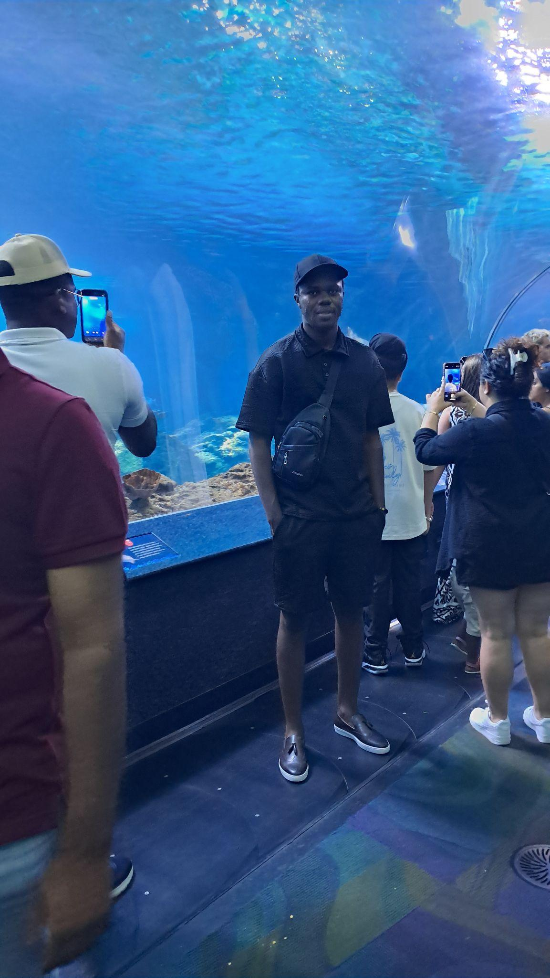
1. Who are we?
Oliver
Cyrille

Slide 4

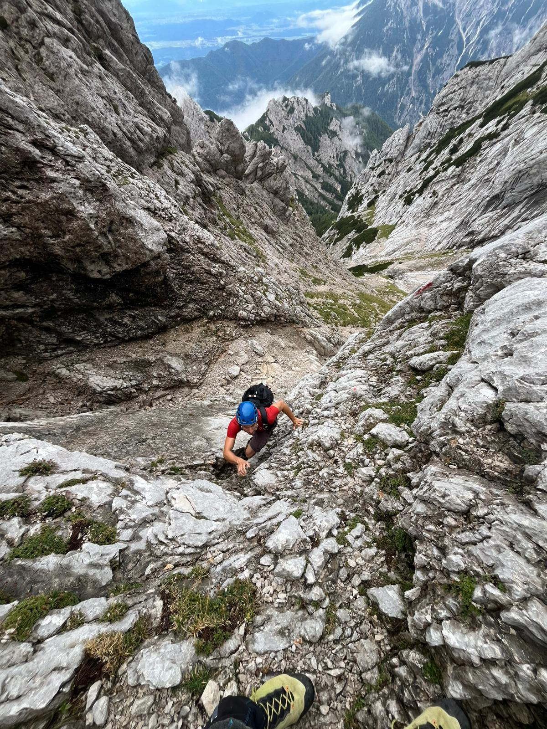
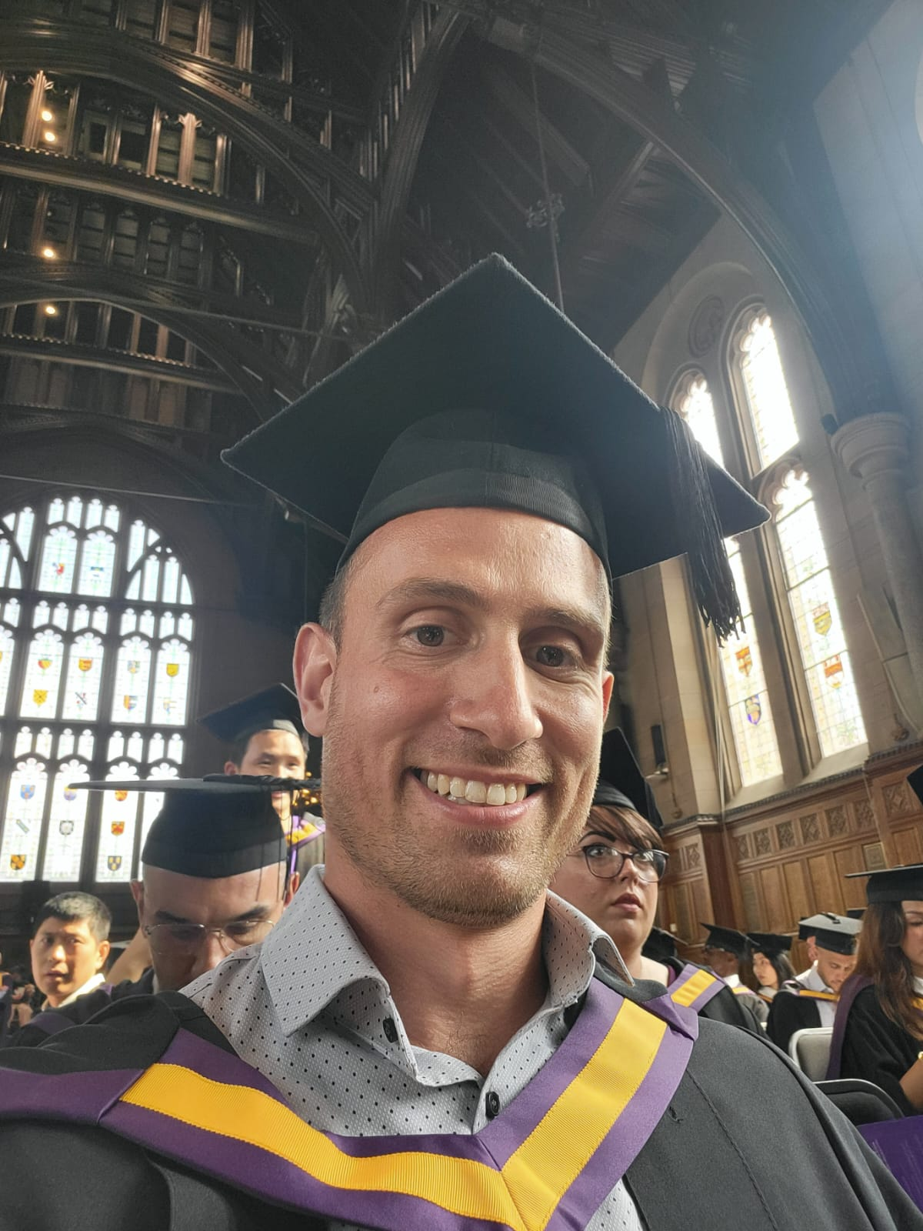
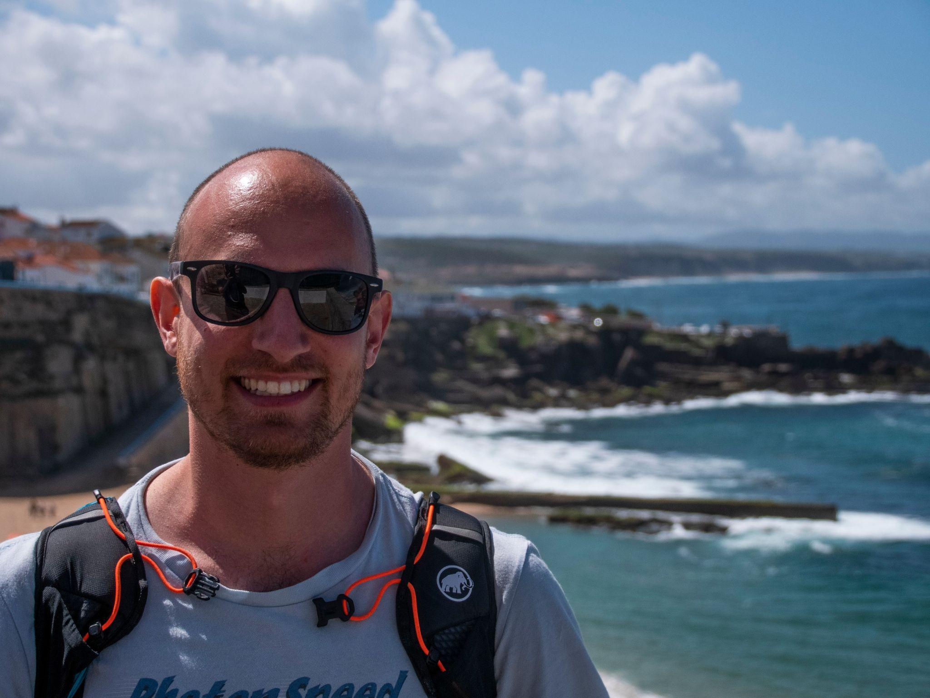
1. Who are we?
Vincent ("Mr. API")
Jan
photo eating chicken
photo eating chicken with jollof
photo eating chicken with waakye

Slide 5
2. Our career journeys
Oliver
2010
2012
2013
2014
UCT
ETHZ
MeteoSwiss
LBNL
Earth & Environmental Science
MSc Climate Science & Statistics
Analysis of Weather & Climate Data for the Swiss Government
Research Assistant & Computer Systems Engineer
2015
2018
2021
2023
UNSW
Credit Suisse
Ishango.ai / AIMS Rwanda
Barry Callebaut
PhD Climate Science & Statistics
Senior Data Scientist
Ishango.ai is founded
Freelance Data Scientist in Manufacturing

Slide 6
2. Our career journeys
Cyrille
2014
2017
2020
2021
UDS
ENSPD
PJT
AIMS-CAMEROON
BSc Mechanics & Energetics
MEng industrial construction technology
Analytics & App consultant
Msc Industrial Mathematics
2021
Ishango.ai
Data Scientist

Slide 7
2. Our career journeys
Vincent
2019
2020
2021
2023
UoG
Mallon Associates / Turntabl
Citi
Morgan Stanley
Statistics and Computer Science
Software Engineering Fellow
Software Development Engineer
Software Engineer
2025
Ishango.ai
Data Scientist

Slide 8
2. Our career journeys
Jan
2010
2014
2016
2019
UL
UL
JSI / UL
PSI
BSc Physics
MSc Condensed Matter Physics
PhD Condensed Matter & Materials Physics
Postdoctoral Researcher
2021
2022
2022
Credit Suisse
DeepLearning.ai
Ishango.ai
Data Scientist
Curriculum Developer
Data Science Consultant

Slide 9
2. Add us on linkedin!
Oliver: https://www.linkedin.com/in/oliver-angelil/
Cyrille: https://www.linkedin.com/in/cyrille-feudjio/
Vincent: https://www.linkedin.com/in/vincent-frimpong/ Jan: https://www.linkedin.com/in/jan-ravnik/

Slide 10
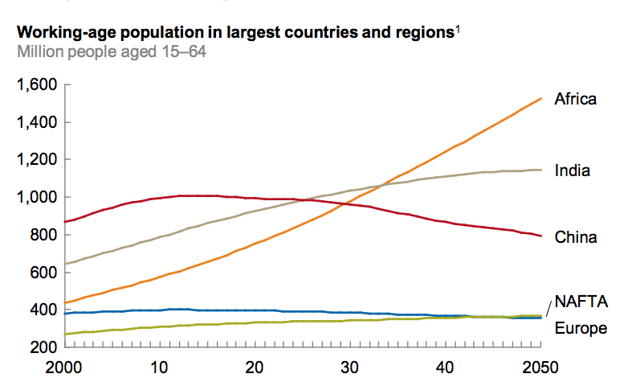
3. Ishango.ai
Africa – the last Frontier to Global Growth
The population in Africa is young and the labor force is growing rapidly – a valuable asset in an aging world
By 2034, Africa’s workforce will be larger than that of either China or India
The challenge for Africa will be to create sufficient jobs for the many millions of young people entering the workforce
Working-age population in largest countries and regions Million people aged 15-64
Source: McKinsey Global Institute Analysis, Lions on the Move II: Realizing the potential of Africa’s economies

Slide 11
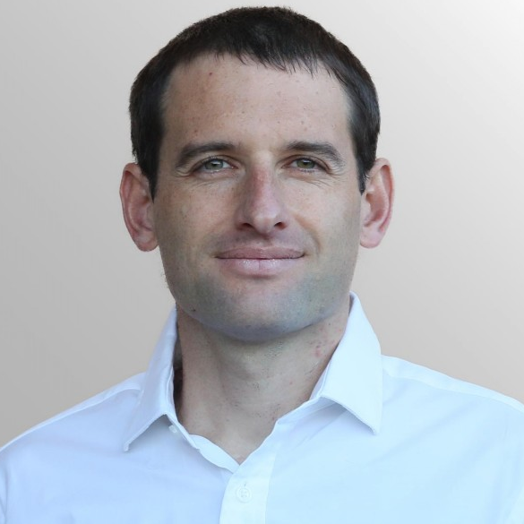

3. Ishango.ai
Ishango.ai founding team
Oliver Angelil
Co-Founder &
Head of DS DE
15+ years of experience in Data Science & Engineering
Ex DS lead at Credit Suisse
PhD and MSc in Climate Research, with deep expertise in AI & ML
oliver@ishango.ai
Eunice Baguma Ball
Co-Founder & Head of Operations
15+ years experience leading social enterprises and managing tech and social impact projects in Africa & Europe
Ex Google. Mst from University of Cambridge eunice@ishango.ai
‹#›

Slide 12
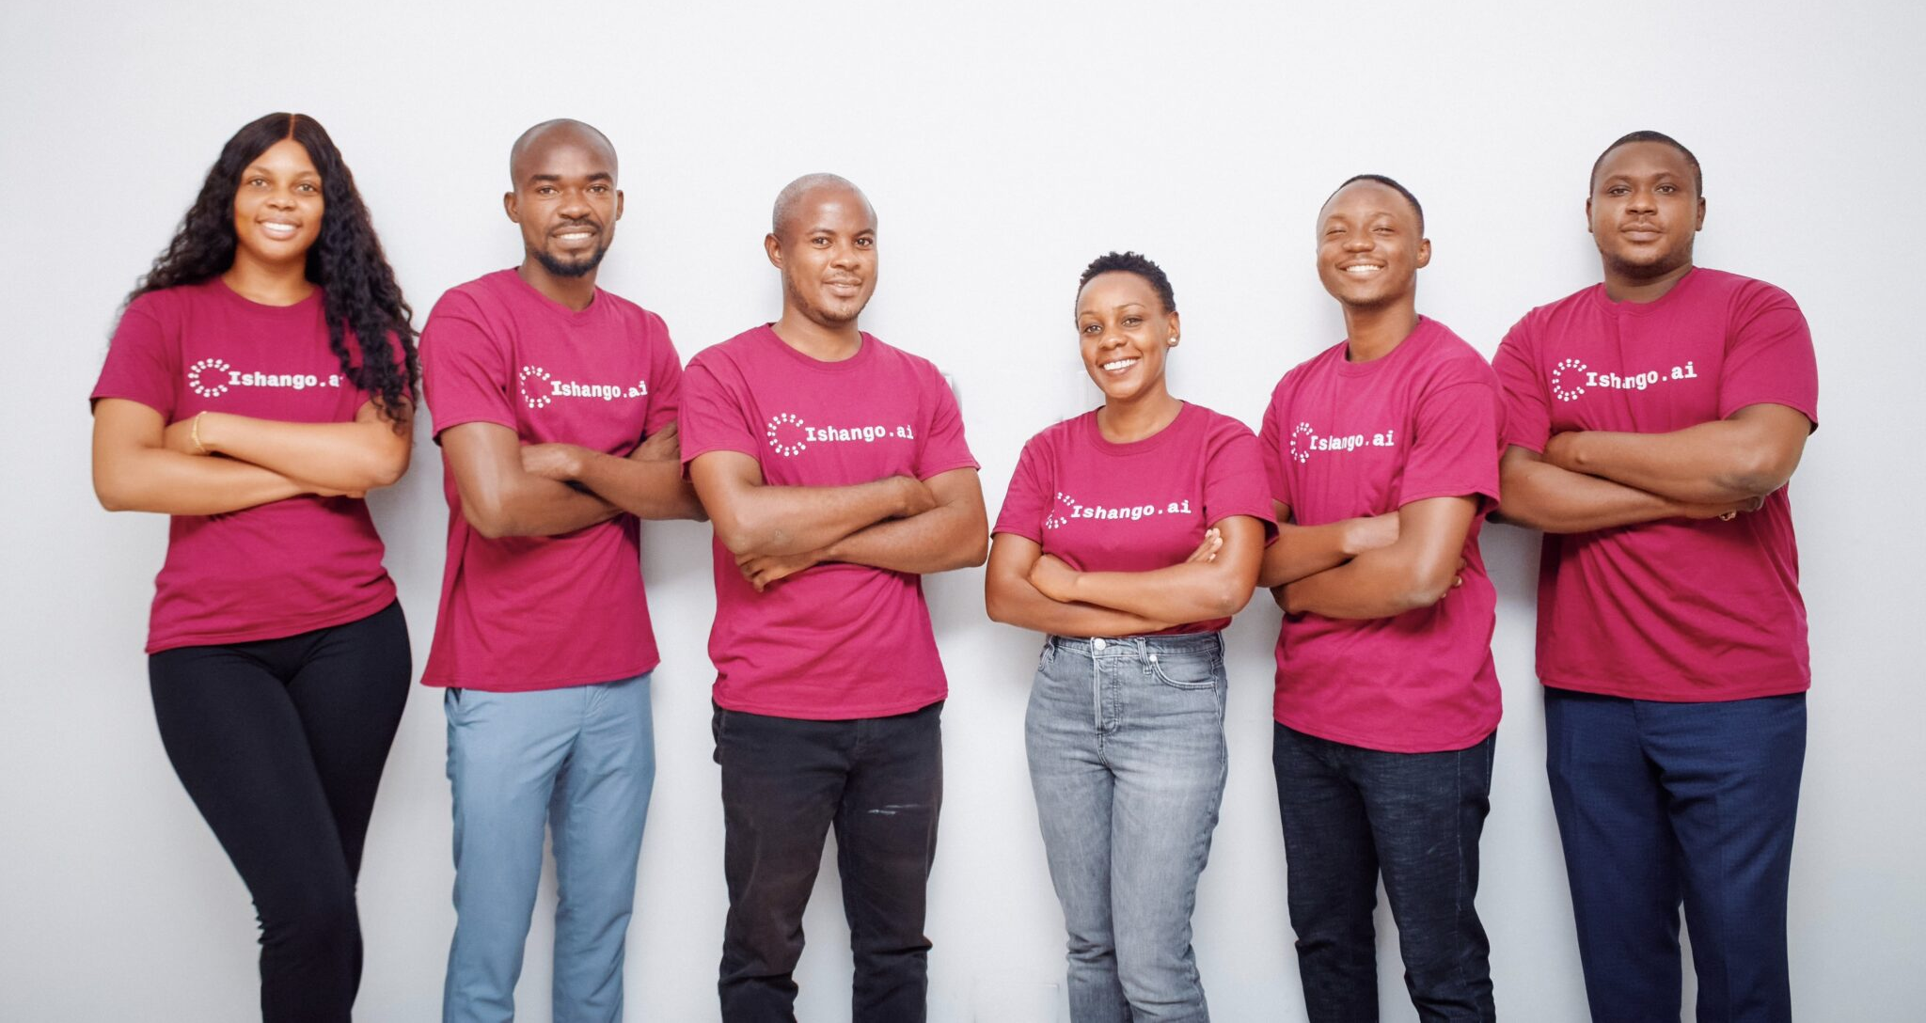




3. Ishango.ai
Our Mission
Positive social impact in creating an inclusive and diverse AI future.
We aim to build the bridge between Africa’s top talent in DS/DE & global businesses
Our mission is to create high quality jobs for top talents entering the workforce in Africa
We want to demonstrate the wealth of talent and skills available
‹#›

Slide 13




3. Ishango.ai
Our Services
Data & Software Engineering
AI & Machine Learning
Analytics & Dashboards
Data model design and implementation
Databases (e.g. Neo4J, Postgres, MySQL)
Data health checks / unit testing
Continuous integration and deployment (i.e. automation)
Anomaly or object detection
Forecasting and predictive modelling
Recommendation engines
Computer Vision
Natural Language Processing (NLP)
Large Language Models (LLM) & Generative AI
Visual analytics solutions
Management Interface (MI) Dashboards
Business Intelligence (BI) solutions for mobile devices
Automated reporting capabilities

Slide 14

4. What is this AIMS course about?
Overarching Goals
Having fun!
Learn industry-relevant content
Knowledge transfer via...
Lecturing
Question-Answering
Discussions
Confidence building
give all students a voice
empower you to believe that you can build anything

Slide 15


4. What is this AIMS course about?
Skills Prerequisites
More useful skills for this course
Curiosity & self-motivation
Programming
Learning modern concepts & technologies
Almost irrelevant skills for this course
Being good at mathematics
✘
✔

Slide 16
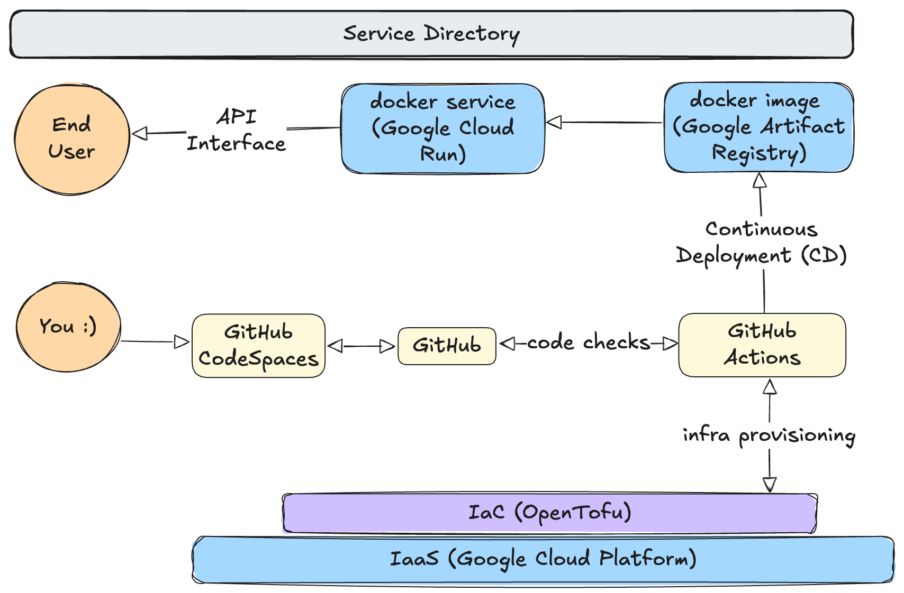

4. What is this AIMS course about?
this course
.ipynb (jupyter / Google Colab)
Production
DevOps
Exploratory Data Analysis (EDA)
"Quick & Dirty" testing of ideas
Short projects (weeks - months)
Usually one developer/programmer
No end-users / stakeholders (low stakes)
No code reusability
Use Case Examples:
AIMS MSc thesis
Scientific Research
Machine Learning Prototyping
.py files
Usually teams of developers
Many Users (often not technical) will interact with it (high stakes)
Modularity & Reusability
Version controlled (git)
Coding Best Practices
Use Case Examples:
User-facing web applications
automated data pipelines
ML lifecycle systems (MLOps: data drift; model versioning; inference APIs)

Slide 17
4. What is this AIMS course about?
Curriculum
Week 1
Lecture 1: Introduction & basic App deployment — Oliver, Cyrille, Jan, Vincent
Lecture 2: RESTful APIs with Docker — Oliver
Lecture 3: Software development best practices — Cyrille
Lecture 4: CI/CD with GitHub Actions — Vincent & Cyrille
& Assignment 1 Introduction
Lecture 5: Steamlit & Gradio — Cyrille

Slide 18
4. What is this AIMS course about?
Curriculum
Week 2
Lecture 6: Data Engineering (Foundation & Building Blocks) — Oliver & Vincent
Lecture 7: Data Engineering (The DE Lifecycle in Depth) — Oliver & Vincent
Lecture 8: Data Engineering (Learning by Doing: Building your own DE pipeline with Dagster) — Oliver & Vincent
Lecture 9: End-to-end ML lifecycle — Cyrille
& Assignment 2 Introduction
Lecture 10: End-to-end ML lifecycle — Cyrille

Slide 19
4. What is this AIMS course about?
Curriculum
Week 3
Lecture 11: Distributed vs Single-node compute — Oliver
Lecture 12: Agentic AI — Jan
Lecture 13: Agentic AI — Jan
Lecture 14: Agentic AI — Jan
& Assignment 3 Introduction
Lecture 15:
Oliver, Cyrille, Jan, and Vincent will prepare a lecture on whatever technical topic you like. Provided it is a useful skill, and not just a trendy AI topic :)
A classroom discussion about Academia versus Industry

Slide 20
5. Grading Breakdown
55%: Multiple choice test (5 multiple choice questions) every morning about the content lectured in the previous day
5%: Submission of 1 question from each student on slido, about the content lectured on the previous day. You will upvote the questions that you like the most.
40%: Assignments
1: Basic App deployment
2: Train an ML model and log different versions using MLflow
3: Build an end-to-end agentic AI application

Slide 21
6. Slido Surveys
Click this link and let's collect some data from you all!
Participant link
Admin Link (ishango.ai team only)

Slide 22
7. Get-to-know game
Sit down if...
Self-assessment ordering
link (for instructors)

Slide 23
8. Deploying a basic end-to-end App on GCP

Slide 24
8. Deploying a basic end-to-end App on GCP
Deployment Instructions
https://github.com/Ishangoai/AIMS_course/wiki/Deploy-as-a-member-of-the-Github-repo

